Slide 1
Recognizing stages of Depression & Optimizing through Guided Imagery
PROGRESS SEMINAR 3
Session 2023-24
(G11)
Guided by
Prof. Nikita P. Giradkar
Projectees
Rishita Uikey
Saloni Urade
Arpita Mishra
Sakshi Deshmukh
Achal Akulwar

Slide 2
Problem Definition
Depression is increasing day by day and people are not aware of there suffering which leads to lack of activity and emotionally unstable (they fail to understand about emotion or their thinking) and in worst case death (suicide) is occur due to depression.
To decrease the death rate and optimize the disorder from beginner stage we are introducing our project which detect the depression and give solution through guided imagery.

Slide 3
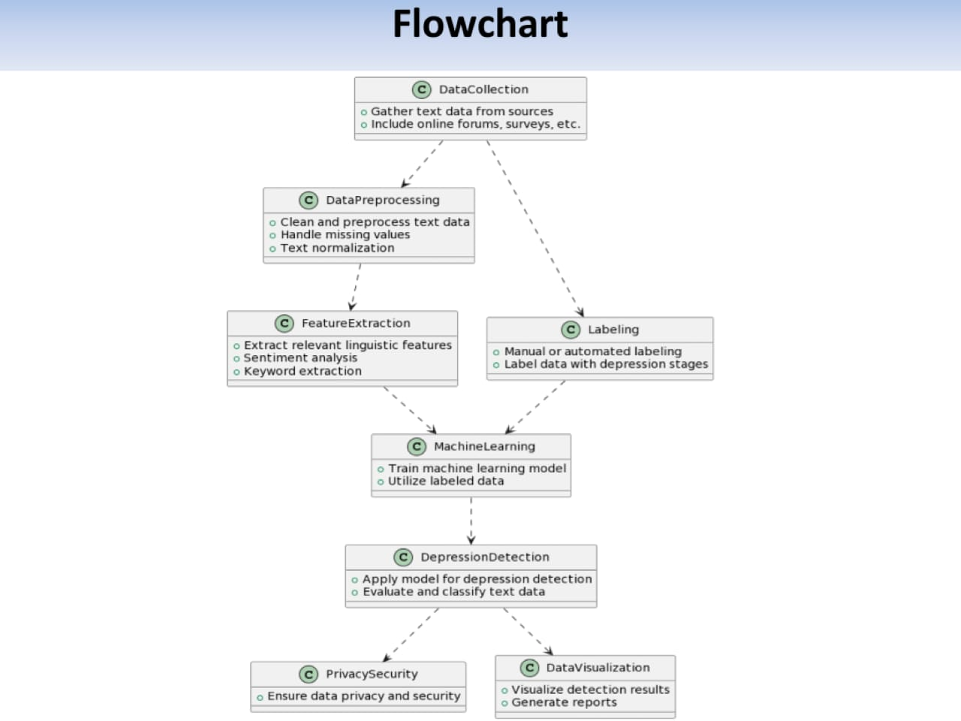

Work done

Slide 4
Literature Survey
Sr no. | Title Of the Paper | Author | Major Observations/Findings
1 | Depression detection using emotional artificial intelligence and machine learning:A closer review(2022) | Manju Lata Joshi a, Nehal Kanoongo b | This study analyses how facial expressions, images,emotional chat_x0002_bots and texts on social media platforms can effectively detect one’s emotions and then depression. Naïve-Bayes,support vector machines,Long term short memory-Radial neural networks,logistic regression,linear support vector are various ML techniques used to recognize emotions from text processing. Artificial neural network is used for feature extraction. Classification of images to detect emotions through facial expressions.
2 | Deep Learning for depression detection from Textual Data(2022) | Amma Amanat 1,Muhammad Rizwan 1,*,Abdul Rehman Javed 2,Maha Abdelhaq 3,Raed Alsaqpour, Sharmil Pandya ,Mueen Uddin | Productive model by implementing long short term memory model, consisting of two hidden layers.Large bias with Recurrent Neural Network with two dense layers. Train RNN on textual data to identify depression from text, semantics, written content.
3 | Machine Learning Algorithms for Depression : Diagnosis, Insights and Research Directions(2022) | Shumaila Aleem, Noor ul Huda, Rashid Amin,*,Samina Khalid, Sultan S. Alshamrani, Abdullah Alshchri | General model diag_x0002_nosis involving data extraction, pre-processing, training ML classifier, detection classification, performance evaluation. Identify Objectives, limitations of different research studies presented in the domain.
4 | Depression Detection using Machine learning techniques(2021) | Kuhaneswaran A/I,Govindasamy,Naveen Palanichamy | Twitter data is fed into different type of classifier i.e. Naive Bayes and Hybrid model,NBTree.

Slide 5
Proposed Methodology
Questions and Options
Graphical User Interface (GUI)
Randomized Question Order
4.Data Storage
5.Scoring
6.Result Display

Slide 6
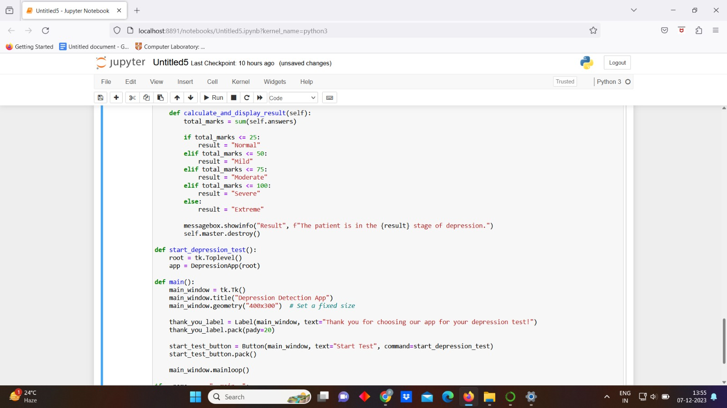
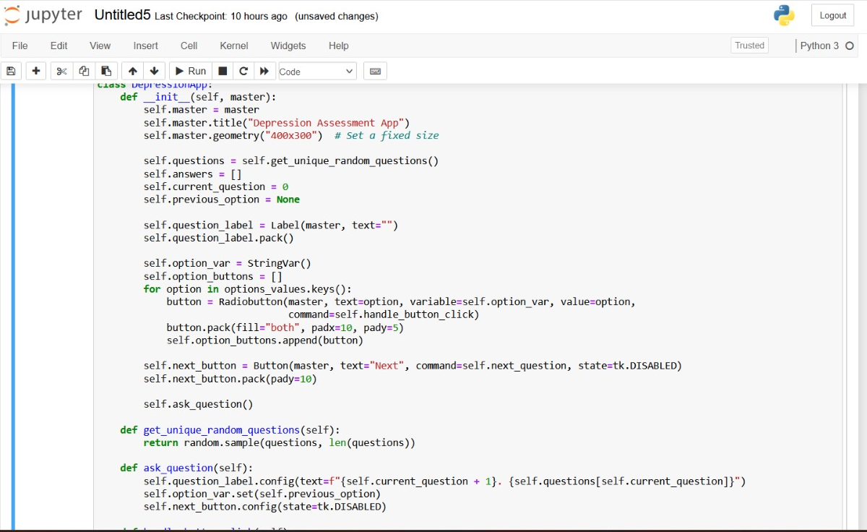
Outcome

Slide 7
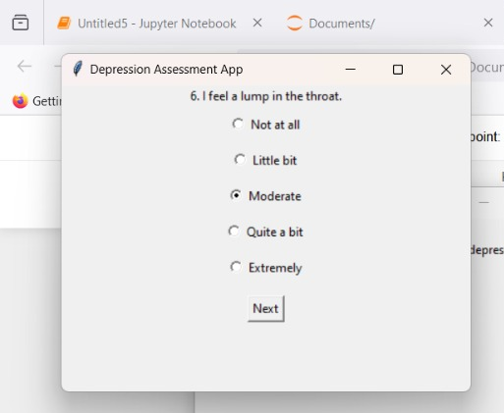
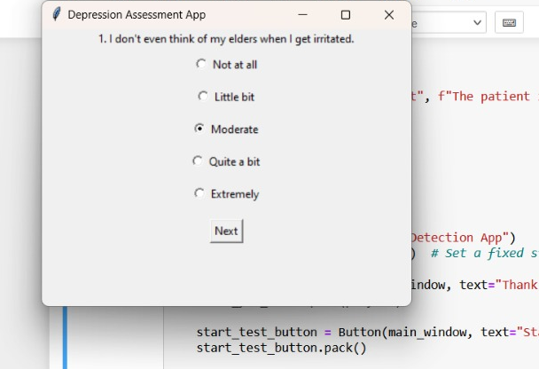
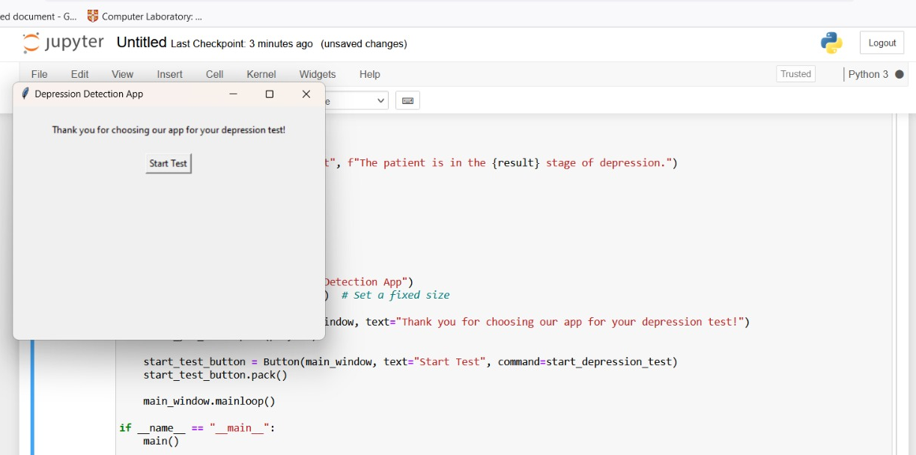
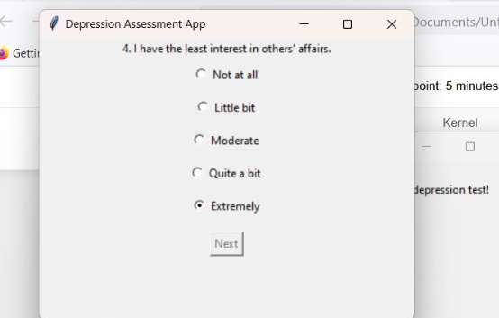
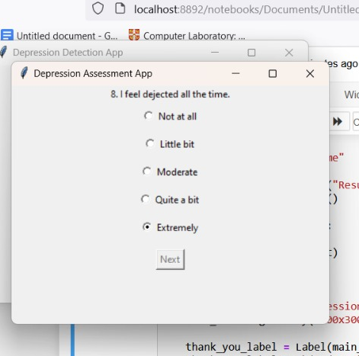


Result

Slide 8
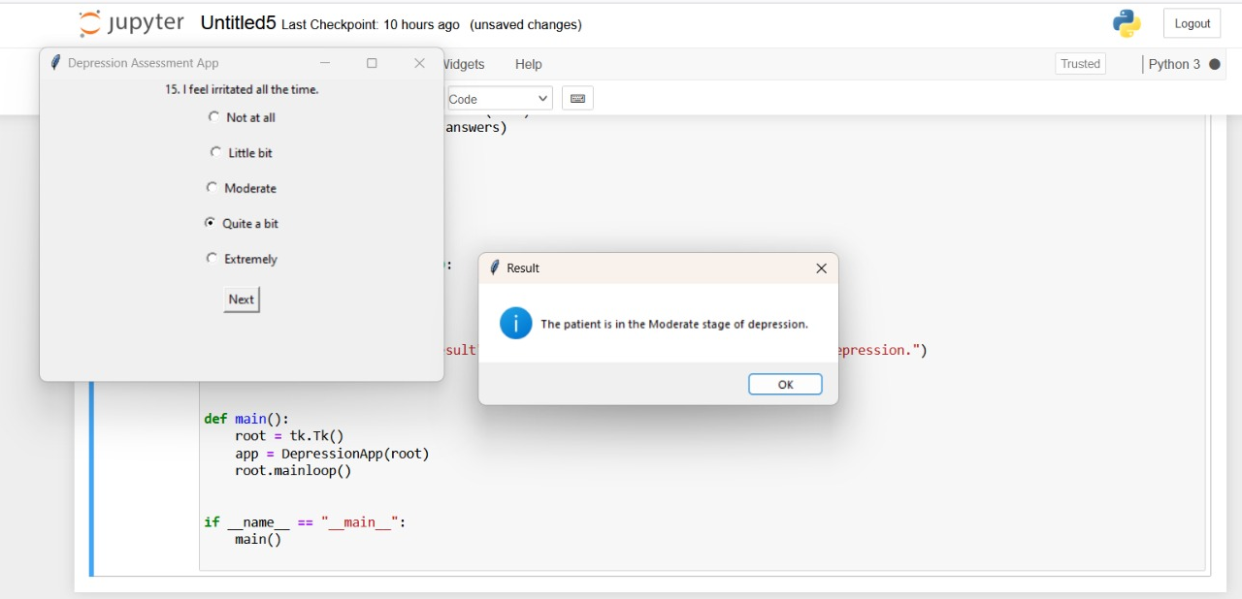
Conti……

Slide 9
THANK YOU……

